Slide 1
LECTURE: 5
Search Strategies

Slide 2
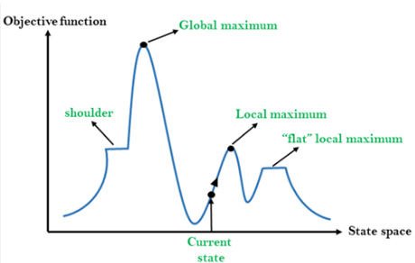
Hill Climbing
Hill climbing seeks optimal solutions locally.
It moves towards increasing value/elevation.
Terminates when no better neighbors exist.
Also called greedy local search technique
Requires good heuristic and single state.
Example: Solving Traveling Salesman Problem.

Slide 3
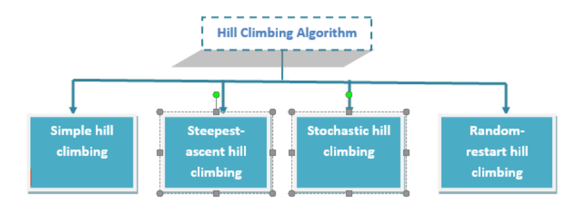
Types of Hill Climbing

Slide 4
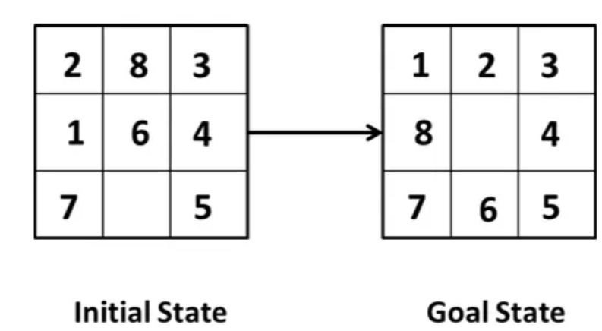
Simple Hill Climbing
Evaluates current state for possible improvement.
Chooses best neighboring state to move.
Moves if neighbor is better than current.
Stops if no better neighbor exists.
Aims to find goal state.
Eg: 8-puzzle

Slide 5
Algorithm for Simple Hill Climbing
Step 1: Evaluate initial state, check goal.
Step 2: Loop until solution or no operators.
Step 3: Apply operator to current state.
Step 4: Check if new state is better.
Step 5: If better, update to new state.
Step 6: Exit when goal is found

Slide 6

Steepest-ascent Hill Climbing
Evaluate all possible neighboring states.
Choose the neighbor with highest value.
Move to the best neighboring state.
Repeat until no better move exists.
Eg: GPS, Manufacturing Process Optimization

Slide 7
Algorithm for Steepest-ascent Hill Climbing
Step 1: Evaluate initial state, check if goal.
Step 2: Initialize BEST_SUCCESSOR to no improvement
Step 3: Apply operators and evaluate new state.
Step 4: If goal, return success and stop.
Step 5: If better than BEST_SUCCESSOR, update.
Step 6: Stop when no further improvement possible.

Slide 8
Stochastic Hill Climbing
Evaluate initial state, check for goal.
Randomly select one neighboring state.
Compare selected state to current state.
Move if new state is better.
Repeat until goal or no improvement.
Eg: Stock Portfolio Optimization

Slide 9
Algorithm for Stochastic Hill Climbing
Step 1: Start with an initial random state.
Step 2: Generate a random neighboring state.
Step 3: Evaluate the new state's objective value.
Step 4: Move if new state is better
Step 5: Repeat until goal or no improvement.
Step 6: Stop when no better neighbors found.

Slide 10
Random Restart Hill Climbing
Begin at a random starting point.
Perform hill climbing to find goal.
If stuck, restart at another point.
Avoids being trapped in local maxima..
Repeat process to improve success probability.
Helps find global maxima more reliably.

Slide 11
Algorithm for Random Restart Hill Climbing
Step 1: Start with a random initial state.
Step 2: Perform hill climbing to find solution.
Step 3: If stuck, record best solution found.
Step 4: Restart process with a new random state.
Step 5: Repeat until goal or time limit.
Step 6: Return best solution among all attempts.

Slide 12
NEXT: Explore Annealing, Best-First Search, and differences.

